Slide 1
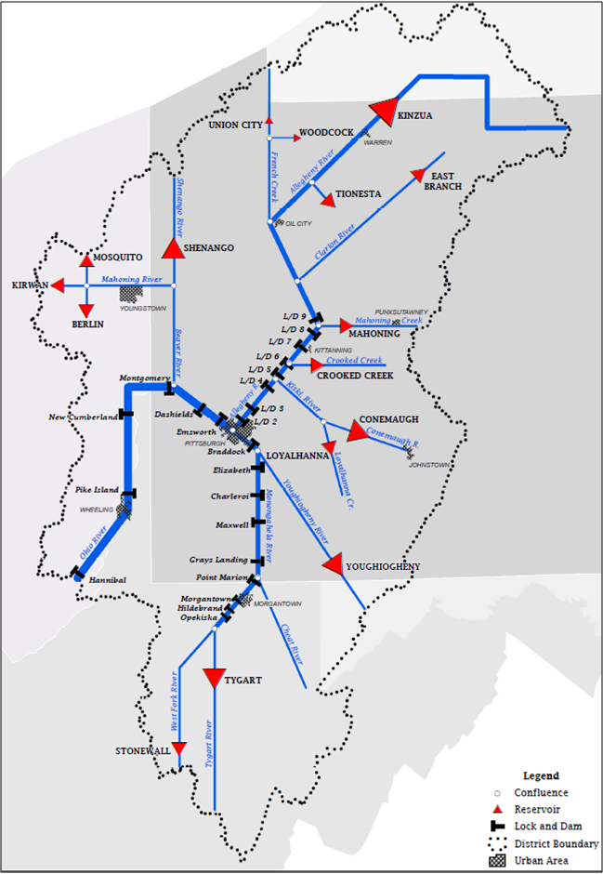
Pittsburgh District Operations Readiness
Unclassified
FOUO
Fully Operational
Restricted Operations
Out of Operation
Repair Fleet
LRP Top “System” Issues:
05 August, 2016
Ohio River L/D
RP/Fleet
# Oper
Notes:
Issue: O&M – Montgomery L/D dam
Status: Contract expected for fabrication of two additional lift gates by EOY. Contract currently in process for installation of two lift gates with an option for installation of a third. LRP will continue to budget for fabrication and installation of dam gates in FY17 and FY18. RVD 06-16.
Lock (A)
Lock (P)
Gates
Emsworth Lock (P) RP (05-Jul-16)
14/14
Dashields
Montgomery
8/10 Gate 3 (30 Jan 14), Gate 5 Construction
10/11 Lock (A) (10 Mar 15), Dam Gate 10 out of operation (15 Jun 15)
New Cumberland
Issue: Dam Safety - East Branch Dam Safety Project
Status: Construction on the platform fill continues. Hauling of stone continues on both day and night shifts. RVD 06-15.
9/9
Pike Island
Hannibal
Monongahela River L/D
Braddock 4/4
Lock 3
Lock 4
5/5
Maxwell Dam Gate 3 Out of Service (8-Jun-16)
Issue: O&M - Upper Mon and Upper Allegheny service reduction Standard Levels of Service
Status: IMTS LOS 6 Locks and Dams. LRP is working on developing standards for maintenance, security, safety, and environmental compliance at these facilities. RVD 01-14.
4/5
Issue: O&M - Upper Mon and Upper Allegheny service reduction iaw Standard Levels of Service
Status: As Opekiska, Hildebrand and Morgantown move to “Caretaker” status, can we execute a viable PPP?
Grays Landing
Point Marion
6/6
Morgantown
6/6 IMTS LOS 3
6/6
Hildebrand
IMTS LOS 6 Commercial Lockage by Appointment Only
Opekiska
Allegheny River L/D
4/4
Lock 2
Issue: CG - Lower Mon Project
Status: Need a viable strategy dealing with how should the #2 IMTS priority project be funded. Since project completion date has been extended several years, LRP will continue to submit annual budget packages to keep the lock operational. RVD 01-14.
Issue: O&M Improvement Plan
Status: Finish improvement plan w/ finalized PMP and running, prioritized 1-n list. RVD 01-14.
C.W. Bill Young
IMTS LOS 1 - Hours 24/7/365
Lock 4
Lock 5
IMTS LOS 2 - Hours 0700 – 2300, 7/365
Lock 6
IMTS LOS 6 Commercial Lockage by Appointment Only
Lock 7
Entire System
Lock 8
Lock 9
Northern Area FRM
Southern Area FRM
Fleet
RP
RP
Control
Quality
Dam
Control
Notes
Dam
Quality
Notes
East Branch
Stonewall
Kinzua
Crooked Creek
Berlin
Youghiogheny
Shenango
Tygart West ringjet valve out of operation
Tionesta
Loyalhanna
Woodcock
Conemaugh
Mosquito
Mahoning
MJ Kirwan
As of 05 August 2016 – 1500 hrs
Union City

